Slide 1
The Rise of Dictators
Adolph Hitler and Benito Mussolini

Slide 2
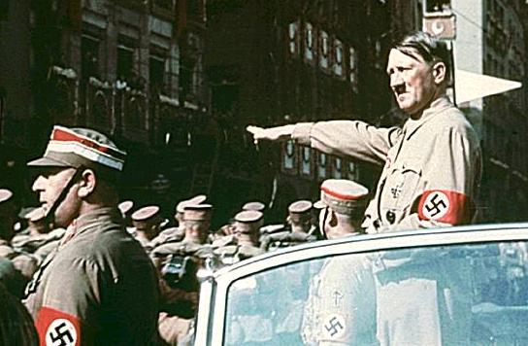
Hitler’s Rise to Power
Fascism
Early Life
WWI Service
Weimar Republic
Mein Kampf
Rise to Power
Demagoguery
A society of racism

Slide 3
Fascism
Fascism: An authoritarian and nationalistic right-wing system of government and social organization.
In the case of Nazi Germany, Hitler used ideas of scientific racism and white supremacy to unite his citizens against the “Jewish threat”.
Totalitarianism where the government controls every aspect of life in a country. Removal of labor unions, human rights, and military control.
Usually involves both terrorism and mass censorship.

Slide 4
Early Life
Born to Alois Schickelgruber and Klara Hitler in Austria.
Faced harsh physical and emotional abuse as a child and young man.
Mother passed away when Adolph was young, the doctor attending her was Jewish.
He wanted to be a priest, then an artist. Was initially refused military service in Austria, and failed out of art school.

Slide 5
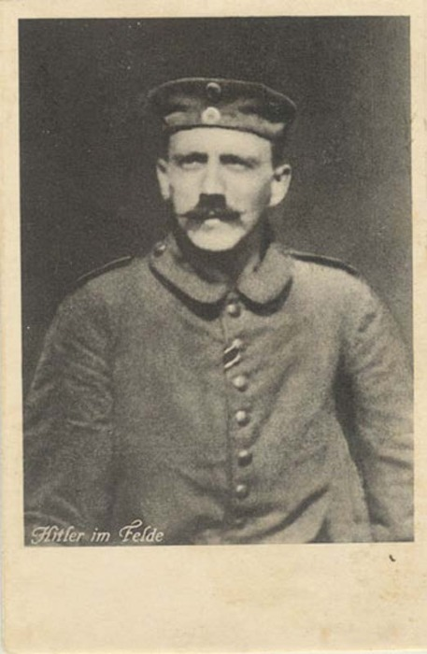
WW I
Serving in the German Army as a courier, he is wounded and received two Iron Crosses for bravery.
Temporarily blinded by mustard gas Oct 1918.
It is said that he crossed no man’s land on Christmas Day and a British Corporal, having compassion on this Holy day did not fire.

Slide 6
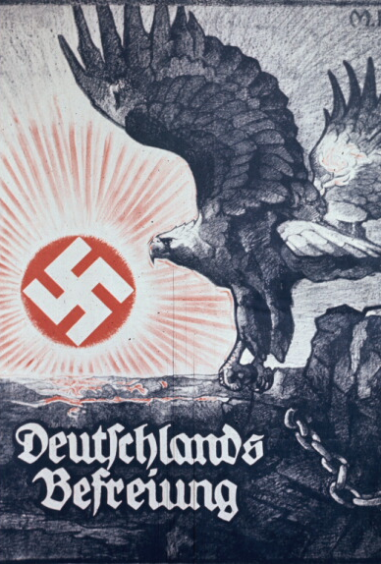
Weimar Republic
Between the death of his mother and the revolutionaries in Germany, Adolph developed a deep hatred for Jewish people.
Adolph worked with the German Workers Party. He held many protests and used intense propaganda to gain support.
During a rally, he resisted the police and received a 5-year prison sentence.

Slide 7
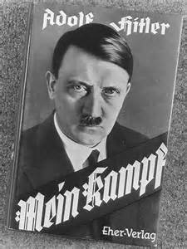
Mein Kampf
He only serves 9 months out of his 5-year sentence.
He writes his book, “Mein Kampf” or “My Struggle” where he outlines his hatred for Jews and non-Germans. He places the blames of Germany’s economic ruin on them.
After prison, Adolph worked harder to gain support through speaking publicly about his idea of a “pure German race”.

Slide 8
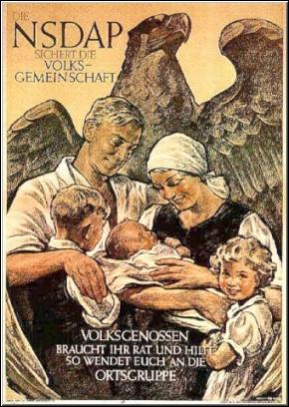

Slide 9
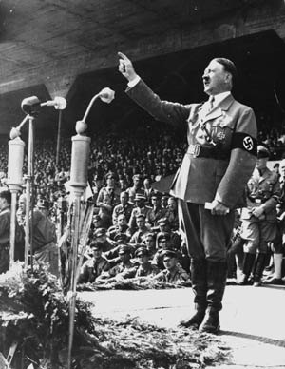
Rise to Power
Hitler becomes a renowned speaker and attracts thousands to his political speeches.
Hitler runs for Chancellor under the Nazi Party and wins. The Nazi Party was the most elected political party during the election.
Begins to put his plans into action and removes anyone who disagrees with him.
Uses rhetoric revolving the idea of “Lebensraum” or the acquiring of land that Germany needed for its natural growth that needed to occur.

Slide 10
Hitler’s Germany and Nazism
Hitler used racism and propaganda in schools to encourage student to distrust and hate Jewish people and non-Aryans.
Hitler’s idea of the perfect citizen was blue eyes, blonde hair, and strong and perfect devotion and discipline.
Gained immense support from many German citizens who felt that he was the only one who could save the from the sanctions of the Treaty of Versailles and the Great Depression.
Creation of concentration and death camps for Jewish people and non-Aryans gave way to the Holocaust.
Main ideas: Anti-Semitism, Euthanasia for elderly and disabled, creation of a “master race”

Slide 11
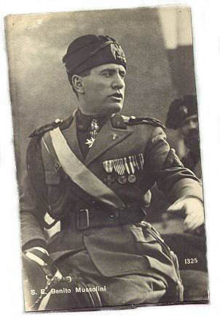
Mussolini’s Rise to Power
Post-WWI Problems
Treaty of Versailles and its effects
Rise to Power
March on Rome
Italy during World War II
Mussolini’s execution

Slide 12
Post-WWI Problems
460,000 Italian soldiers killed.
Enormous debt.
Britain and France refused to give Italy the land that was promised to them.
Rising unemployment let to mass social unrest.

Slide 13
The Treaty of Versailles
Italians felt that they were cheated and were punished beyond reasonable limits.
Italy was not granted the land that they were promised at the Secret Treaty of London
Italy’s foreign Minister left before the conference ended because he felt humiliated over the terms he had been able to secure for his country.

Slide 14
Mussolini gains Power
Mussolini set up and led a Fascist Party and promised to solve Italy’s problems.
Promised to rebuild Italy and recreate the Roman Empire.
Organized armed gangs of enforcers called the “Blackshirts”.
Came to power in 1922 and was appointed Prime Minister by King Victor Emmanuel.

Slide 15
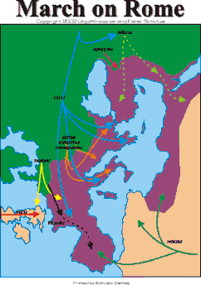
1922 March of Rome
To establish Mussolini and the Fascist Party as the most important party in Italy
In 1921 the fascist parties in Italy joined together to form the Fascist Party
Mussolini said this during a conference for the Fascist Party:
“Either the government will be given to us or we shall seize it by marching on Rome.”

Slide 16
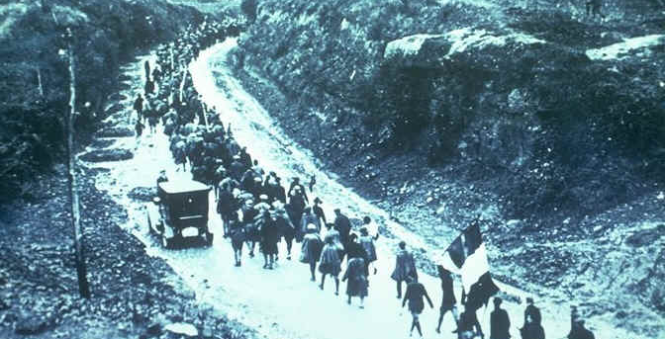
March on Rome, 1922

Slide 17
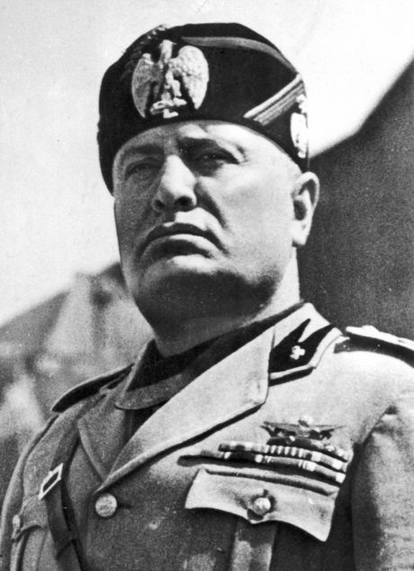
“Fascism should rightly be called Corporatism as it is a merge of state and corporate power.”
~ Benito Mussolini

Slide 18
“Fascism conceives of the State as an absolute, in comparison with which all individuals or groups are relative, only to be conceived in their relation to the State.”
~Benito Mussolini

Slide 19
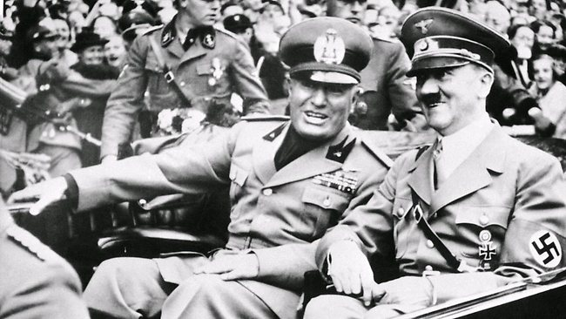
Mussolini and Hitler
Hitler and Mussolini had a close relationship. In October 1936 they signed a non-military alliance. Mussolini signed a full defensive alliance with Nazi Germany in the Pact of Steel.

Slide 20
Italy during World War II
Mussolini intended to annex Malta, Corsica, and Tunis. He wanted to create a “New Roman Empire.” He annexed Albania, straining the military. His troops were unprepared for the German invasion of Poland. Italy remained neutral.
Italy soon declared war on Britain and France but troops were unprepared. It was defeated by Greece and lost the world’s first carrier strike. Italy was defeated on all fronts of the Anglo-American landing.

Slide 21
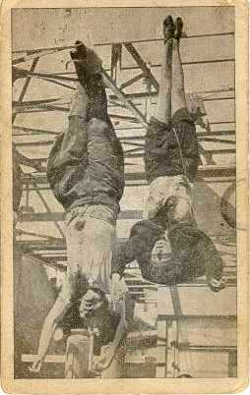
Mussolini’s Execution
Mussolini was taken prisoner by the partisans and was joined by his mistress, Clara Petacci. A few days later they were shot to death. In April of 1945, their bodies were hung at an Esso gas station along with the bodies of other fascist leaders.
Mussolini and his Mistress

Slide 22
Questions:
1. What political group was Hitler involved with before his rise to power?
2. What were two of Hitler’s main ideas from his book Mein Kampf?
3. What were two of the conditions that Italy faced after WW I?
4. What was the name of the defense alliance between Hitler and Mussolini?
5. What did Mussolini want to create?

