Slide 2
The United States Constitution
Checks and Balances

Slide 3
Separation of Powers
Dividing different powers among three branches of government
Prevents one branch from gaining too much power
Legislative, Judicial, and Executive branches have their own unique powers

Slide 4
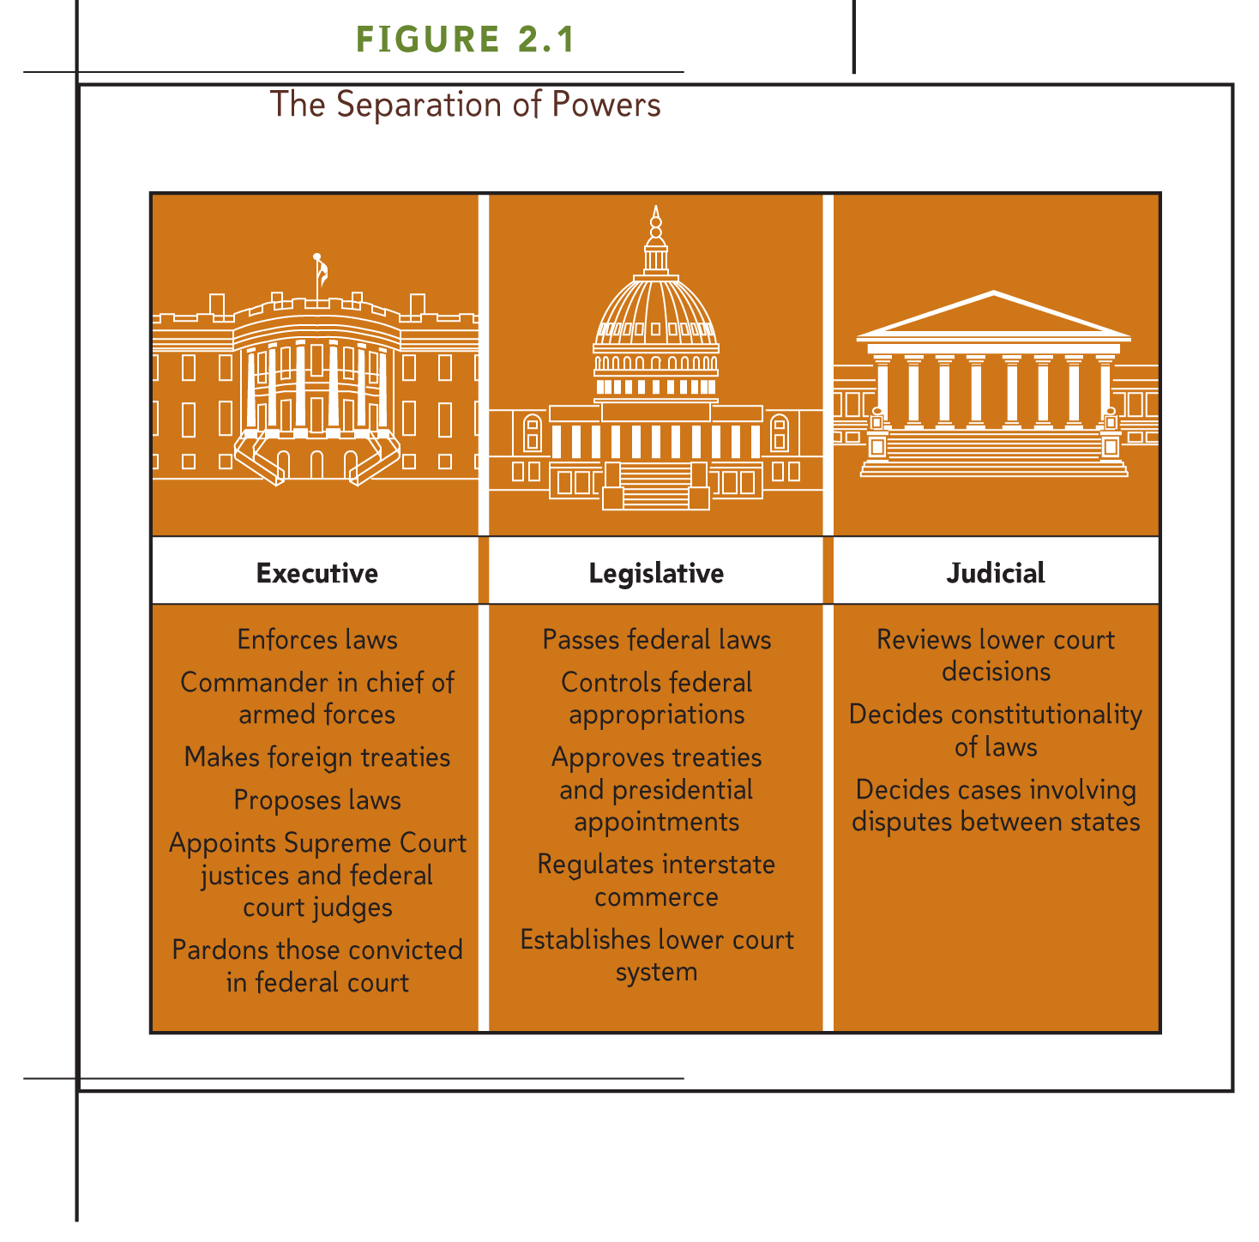

Slide 5
Analysis
Why is it important to separate the powers of the government? Think about the other principles of democracy…

Slide 6
Checks and Balances
Powers each branch has that allows them to check up on the other branches
Prevents branches from abusing their powers
Preserves the separation of powers
Requires cooperation between the branches of government

Slide 7
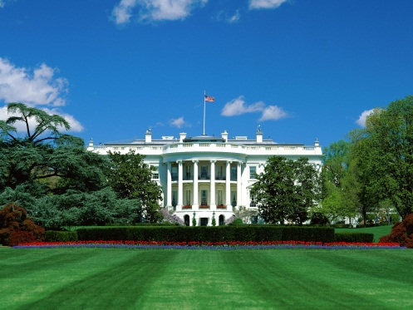
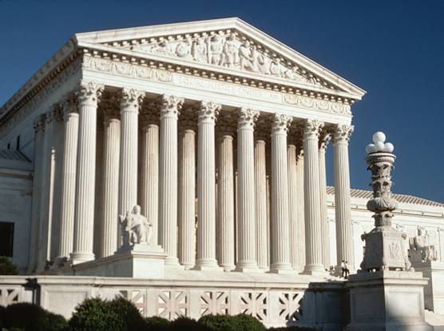
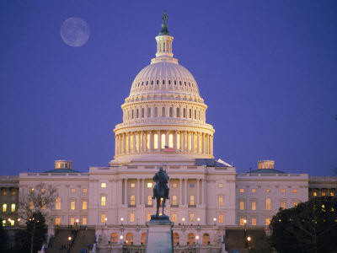
Checks and Balances
Executive
Branch
Judicial
Branch
Legislative
Branch

Slide 8
How can the Legislative Branch (Congress) check and balance the Executive Branch (President)?
May reject presidential appointments
May withhold funding
May impeach President for serious crimes
May override Presidential Veto with 2/3rds
5

Slide 9
How can the Legislative Branch (Congress) check and balance the power of the Judicial Branch (Supreme Court )?
May propose Constitutional Amendments to add to override previous judicial decisions
May impeach Supreme Court Justices for serious crimes
2

Slide 10
How can the Executive Branch (President) check and balance the power of the Judicial Branch (Supreme Court )?
The President appoints justices (judges) to the Supreme Court
With congressional approval
They serve for life, so long as they are not impeached for serious crimes
3

Slide 11
How can the Executive Branch (President) check and balance the power of the Congress (Legislature)?
May adjourn Congress in certain situations
May veto bills that have been passed by Congress
3

Slide 12
How can the Judicial Branch (Supreme Court) check and balance the power of the Congress (Legislature)?
May declare laws of Congress Unconstitutional if they contradict the Constitution
This power is called Judicial Review
2

Slide 13
How can the Supreme Court (Judicial) check and balance the power of the President (Executive)?
May declare Executive actions unconstitutional
If they contradict the Constitution
2

Slide 14
Checks and Balances Worksheet
Executive
Branch
Judicial
Branch
Legislative
Branch

Slide 15
Checks and Balances Scenarios

Slide 16
1. The President vetoes the Gun Bill, which outlaws assault weapons. The Bill has a great deal of support in Congress.

Slide 17
1. Answer
Branch that can Check/ Stop the Action
The Legislative Branch
What Branch can do to Check/ Stop the Action
Congress can override the Presidential veto with a 2/3 majority vote (in both the House of Representatives and the Senate)

Slide 18
2. Congress passes the Internet Decency Act, which attempts to limit young people’s access to profanity on the internet. Some believe that the law violates the First Amendment guarantee of free speech.

Slide 19
2. Answer
Branch that can Check/ Stop the Action
The Executive Branch
The Judicial Branch
What Branch can do to Check/ Stop the Action
The President can veto the bill
The Supreme Court can declare the law Unconstitutional

Slide 20
3. President Nixon is accused of being involved in illegal activities that include obstructing justice and abusing his presidential powers.

Slide 21
3. Answer
Branch that can Check/ Stop the Action
The Legislative Branch
What Branch can do to Check/ Stop the Action
Congress can impeach* and remove the President
*Impeach = charge a government official with immoral, unethical, or unprofessional behavior due to a crime committed while in office or because of behavior that is not right or proper

Slide 22
4. Congress passes the War Powers Resolution, which demands the President notify Congress within 48 hours of sending military forces into battle and gives Congress the power to halt the use of force within 60 days.

Slide 23
4. Answer
Branch that can Check/ Stop the Action
The Executive Branch
The Judicial Branch
What Branch can do to Check/ Stop the Action
The President can veto the bill
The Supreme Court can declare the law Unconstitutional

Slide 24
5. Justice Souter steps down from the Supreme Court.

Slide 25
5. Answer
Branch that can Check/ Stop the Action
The Executive Branch
The Legislative Branch
What Branch can do to Check/ Stop the Action
The President can nominate Supreme Court Justices
The Senate approves Presidential appointments to all Federal courts

Slide 26
6.Congress passes legislation to establish a 5pm curfew for everyone 20 years old and younger.

Slide 27
6. Answer
Branch that can Check/ Stop the Action
The Executive Branch
The Judicial Branch
What Branch can do to Check/ Stop the Action
The President can veto the bill
The Supreme Court can declare the law Unconstitutional

Slide 28
7. The Chief Justice of the Supreme Court offers to sell his vote to the highest bidder during a court case.

Slide 29
7. Answer
Branch that can Check/ Stop the Action
The Legislative Branch
What Branch can do to Check/ Stop the Action
The Congress can impeach* and remove judges
*Impeach = charge a government official with immoral, unethical, or unprofessional behavior due to a crime committed while in office or because of behavior that is not right or proper

Slide 30
8. The President negotiates a treaty to sell all U.S. nuclear weapons to Iran.
Iranian President Mahmoud Ahmadinejad
American President Barak Obama

Slide 31
8. Answer
Branch that can Check/ Stop the Action
The Legislative Branch
What Branch can do to Check/ Stop the Action
Congress can reject or approve treaties with foreign countries

Slide 32
9. The President issues an executive order to the Environmental Protection Agency that orders all people living within Washington State to relocate to Oregon. The order does not provide any compensation for their land and is taking place in order to save the pink katydid from extinction.

Slide 33
9. Answer
Branch that can Check/ Stop the Action
The Judicial Branch
What Branch can do to Check/ Stop the Action
The Supreme Court can declare executive actions unconstitutional.

