Slide 1
Welcome to
Sinagua Middle School’s
IB Parent Night
In the chat, please type in your student’s name and your name.

Slide 2
Sinagua is an
International Baccalaureate World School candidate school!
Sinagua began the IB journey four years ago and is well on the way to becoming authorized. This means that after our authorization visit in October, we will join thousands of prestigious IB schools worldwide.
IB schools share the philosophy of educating students to be successful members of an ever-changing global society.
In an IB Middle Years Programme (MYP), all students are provided with a framework of learning to become creative, critical and reflective thinkers.

Slide 3
The IB Mission
The International Baccalaureate aims to develop inquiring, knowledgeable and caring young people who help to create a better and more peaceful world through intercultural understanding and respect.
To this end, the organization works with schools, governments and international organizations to develop challenging programmes of international education and rigorous assessment.
These programmes encourage students across the world to become active, compassionate and lifelong learners who understand that other people, with their differences, can also be right.

Slide 4
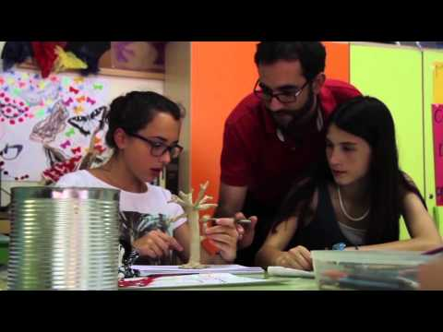
What is the Middle Years Programme (the MYP)?

Slide 5
THE IB MIDDLE YEARS PROGRAMME
addresses students’ intellectual, social, emotional and physical well-being.
enables students to understand and manage the complexities of our world, and provides them with the skills and attitudes they need in order to take responsible action for the future.
ensures breadth and depth of knowledge and understanding through the study of eight subject areas.
requires the study of at least two languages to support students’ understanding of their own culture and of others.
provides the opportunity for students to undertake an independent project in an area of personal interest.
An IB education is the result of a dynamic interaction between…
IB learners (who)
teaching and learning in the IB (how)
global contexts for teaching and learning (why) and
the pursuit of significant knowledge and understanding (what).
The IB’s philosophy of education is informed by research and by over 40 years of practical experience in international education. This philosophy remains open to reflection and review; the IB has always championed a stance of critical engagement with challenging ideas, one that both values the past and remains open to innovation.

Slide 6
Benefits for Students
Students at International Baccalaureate® (IB) World Schools are given a unique, challenging, and diverse education.
IB learners are:
encouraged to think critically and solve complex problems
drive their own learning
a core part in educational programmes that can lead them to some of the highest-ranking universities around the world
more culturally aware,through the development of a second language
able to engage with people in an increasingly globalized, rapidly changing world.
IB students often perform better
IB students develop strong academic, social and emotional characteristics. They are also likely to perform well academically – often better than students on other curricula.

Slide 7
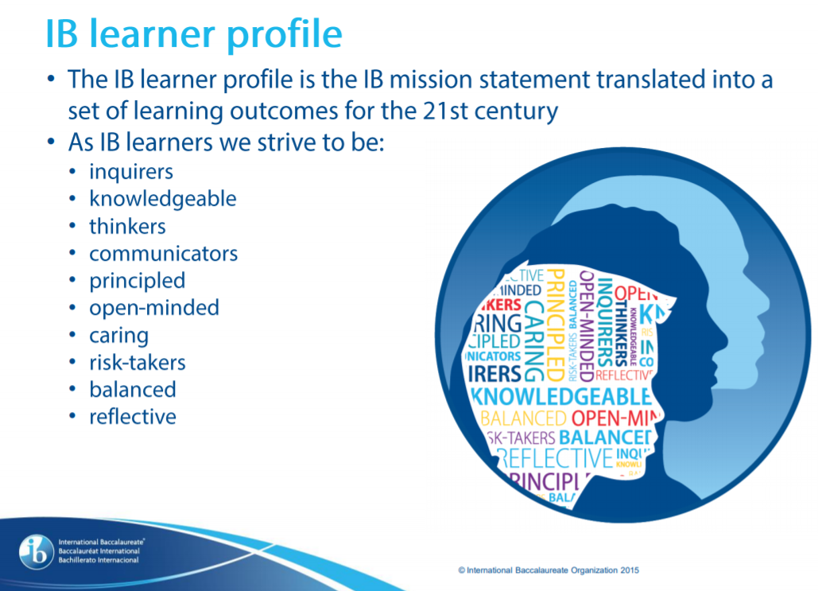
REFLECTING ON OUR SOIs

Slide 8
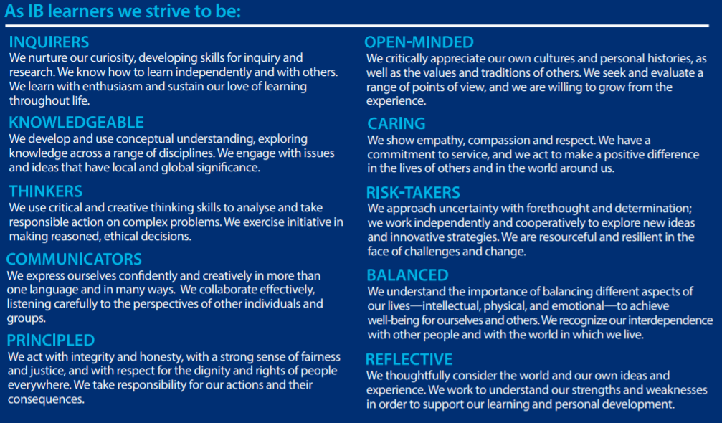

Slide 9
8 Required Subjects
Language & Literature (English Language Arts)
Language Acquisition (Navajo, Spanish, ASL)
Individuals & Societies (Social Studies)
Science (all Science classes, including Biology)
Mathematics (all Math classes, including Algebra)
Design (Woods, Mixed Media, Computer Tech., and Engineering)
Arts (Band, Orchestra, Choir, Art)
Physical and Health Education (P.E., Outdoor Rec., and Weight Training)

Slide 10
Subject Overviews
Language Acquisition (Spanish, Navajo, ASL)
Language and Literature (English)
Mathematics (all math classes including Algebra)
Sciences (all science classes including Biology)
Arts (Band, Choir, Orchestra, Art)
Design (Woods, Mixed Media, Engineering)
Individuals and Societies (Social Studies)
Physical and health education (P.E.)
Disregard section- IV. MYP eAssessment- we are not currently using the eAssessments
SMS will continue using the district Benchmarks and the state assessment Arizona’s Academic Standards Assessment (AASA)-formerly AzM2

Slide 11

Standards Report
Students will see scores of 1-8 on their standards report.

Slide 12
SAMPLE ASSESSMENT CRITERIA
Language and literature assessment criteria: Year 1
Mathematics assessment criteria: Year 1

Slide 13
1.
Implications for 6th grade students
2.
3.
Introduction to the MYP
Terms, language, mission, learner profile, assessment
Inquiry-based learning
The programme empowers students to inquire into a wide range of issues and ideas of significance locally, nationally and globally
Focus on “how” rather than what to learn
Explicit focus on communication, social, self-management, research and thinking skills (the ATLs)

Slide 14
1.
Implications for 7th grade students
2.
3.
Deeper learning
IB mission, learner profile, interdisciplinary, service as action, frequent reflection
Inquiry-based learning
The programme empowers students to inquire into a wide range of issues and ideas of significance locally, nationally and globally
Focus on “how” rather than what to learn
Explicit focus on communication, social, self-management, research and thinking skills (the ATLs)

Slide 15
1.
Implications for 8th grade students
2.
3.
Community Project
Students will undertake an independent service project guided by their own curiosity and passion as well as the intent to serve the community.
Inquiry-based learning
The programme empowers students to inquire into a wide range of issues and ideas of significance locally, nationally and globally
Focus on “how” rather than what to learn
Explicit focus on communication, social, self-management, research and thinking skills (the ATLs)

Slide 16
MYP Community Project
The Community Project is a wonderful opportunity for our 8th grade students to engage in an independent or small group project that they are passionate about and will also benefit our community.
This project serves as a capstone for our 8th grade students.
The Community Project showcases the commitment to service students have developed throughout their experience at Sinagua Middle School.

Slide 17
Community Project Timeline (subject to change)
Students typically begin working on their projects in the first semester and culminate in May. The project is completed in phases
Phase 1: Introduction and Investigating (November
Exploring the definitions of community
Phase 2: Planning (December)
Creating Process Journals
Exploring the types of service
Selecting a topic
Initial topic research
Phase 3: Taking Action (January-February)
Selecting a topic
Initial topic research
Proposal of action
Phase 4: Reflecting (March)
Implementing action plan
Preparing presentation
Reflecting on process
Phase 4: Sharing with the Community (April/May)
SHOWCASE COMMUNITY EVENT

Slide 18
For Community Project...
Students will...
Requirements
Define a goal to address a need in the community
Identify the global context
Develop a proposal for action
Implement action
Share process
Individual or collaborative, but no more than 3 students
15 hours of work meeting with supervisors, conducting research, developing the project and reporting the project
Project must be aligned with a global context
Project must be recorded in a process journal

Slide 19
Four Types of Service
Direct
Indirect
Advocacy
Research
Interaction that involves people, the environment or animals.
Examples include one-on-one tutoring, developing a garden, or teaching dogs behaviors to prepare them for adoption.
No direct interaction with recipients, but the student(s) have verified the benefit to community or environment. Examples include redesigning an organization’s website, writing original picture books to teach a language, or raising fish to restore a stream.
Speak on behalf of a cause or concern to promote action on an issue of public interest.
Examples include initiating an awareness campaign on hunger in the community, performing a play on replacing bullying with respect, or creating a video on sustainable water solutions.
Collect information, analyze data and report on a topic of importance to influence policy or practice.
Examples include conducting environmental surveys, contributing to a study of animal migration patterns, or compiling the most effective means to reduce litter in public spaces.

Slide 20
Closing out our evening with a thinking frame...
See- What did you see in the presentation that stands out to you?
Think- What do you think about the information you heard during this presentation?
Wonder- What do you do you still wonder about?

