Slide 1
Panther Tracks
How we do things at
Coconino High School!

Slide 2
CHS Mission Statement:
To create a vibrant school community that exemplifies academic excellence and model citizenship.

Slide 3

CHS Guiding principles
(school-wide Expectations)

Slide 4

How to stay on the Panther track in the classroom:

Slide 5
Classroom Expectations video Presented by the 2018-2019 Link Leaders
Click HERE

Slide 6
Technology Expectations video Presented by the 2017-2018 Link Leaders
Click HERE

Slide 7
Communicating with teachers proactively is extremely important!
Watch this video Presented by the 2017-2018 Link Leaders for some helpful hints!
Click HERE

Slide 8
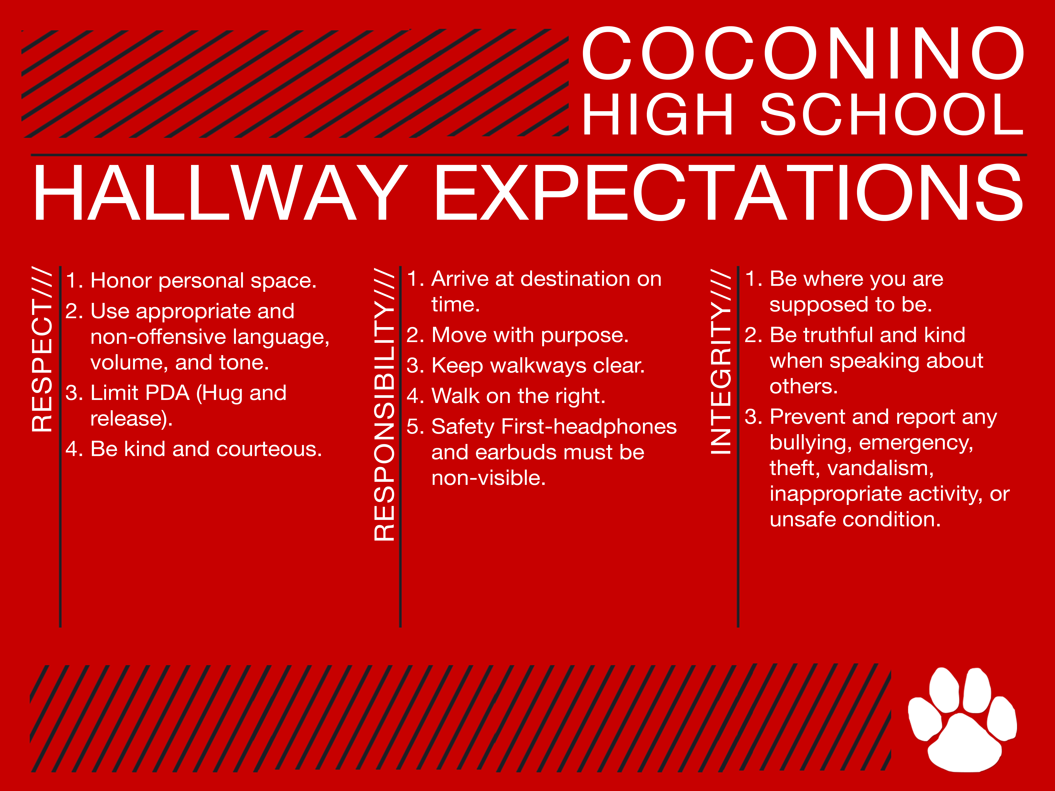
How to stay on the panther track in the Hallways:

Slide 9
Hallway Expectations video Courtesy of the 2017-2018 Link Leaders
Click HERE

Slide 10
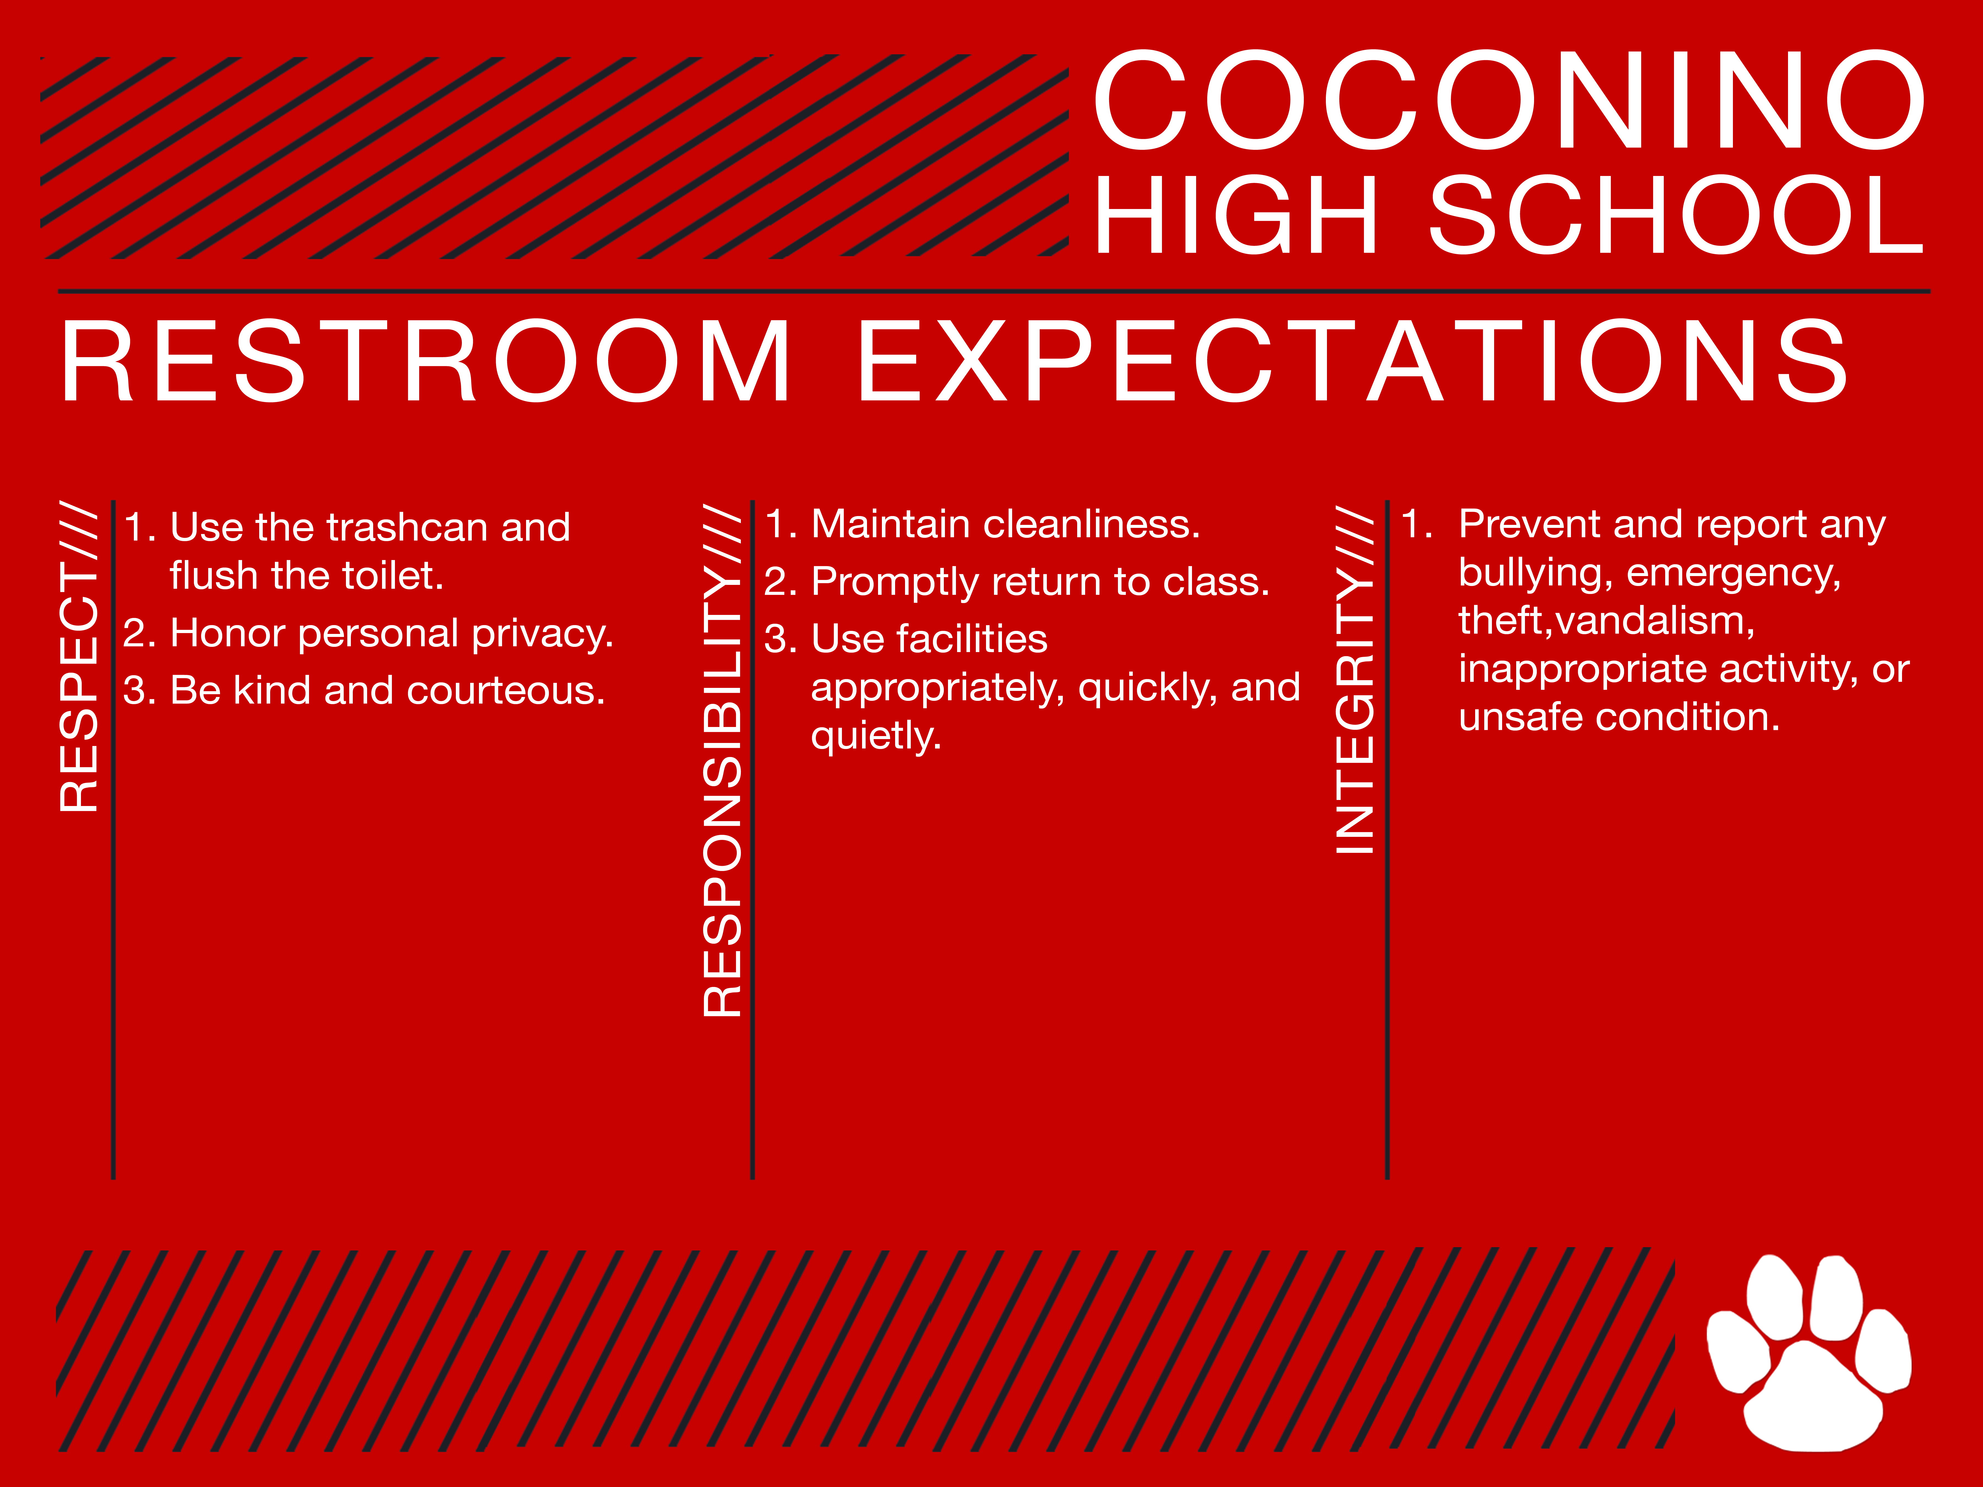
How to stay on the Panther track in the restrooms:

Slide 11
Video for
Restroom Expectations courtesy of the
2018-2019
CHS Link Leaders
Click HERE

Slide 12
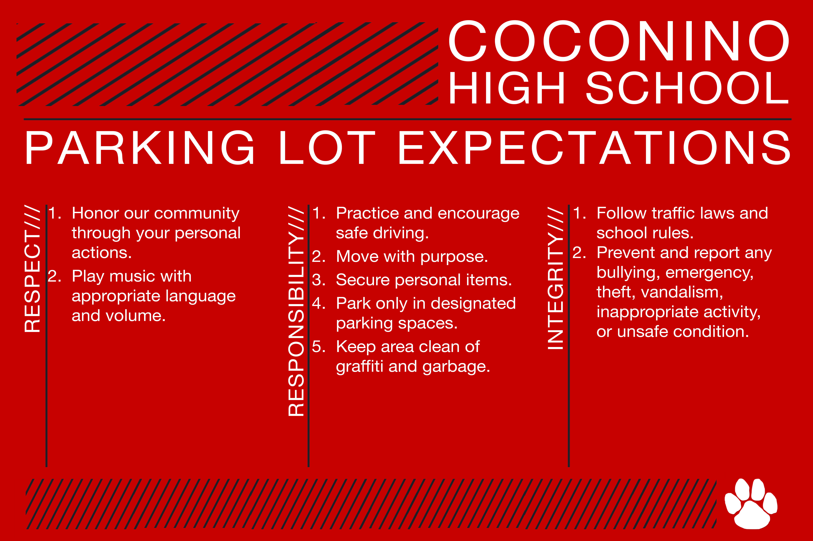
How to stay on the Panther track in the Parking Lot and the community:

Slide 13
Video for
Parking lot Expectations courtesy of the
2018-2019
CHS Link Leaders
Click HERE

Slide 14
How we show the community what coconino is all about…
(PBIS Expectations when you’re off campus)

Slide 15
Video for community Expectations courtesy of the
2016-2017
CHS Link Leaders
Click HERE

Slide 16
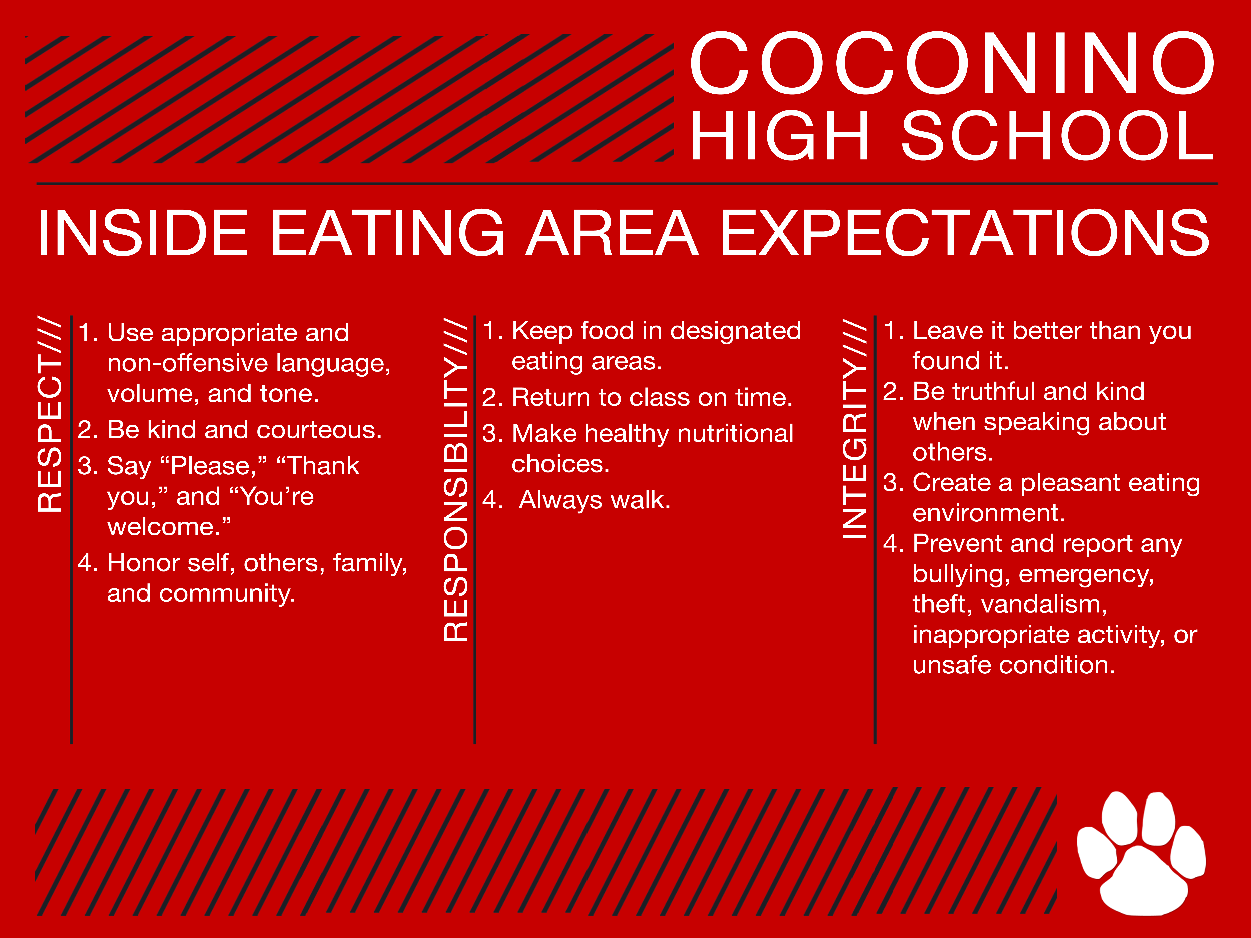
How to Stay on the Panther track in the Inside eating Areas

Slide 17

How to Stay on the Panther track in the outside eating Areas

Slide 18
Eating Area Expectations video Presented by the
2017-2018
CHS Link Leaders
Click HERE

Slide 19
CHS events
Events include: assemblies, sporting events, concerts, plays/musicals, etc.
Events can take place in the gym, auditorium, stadium, fields, cafeteria
Staying on the Panther Track applies to away games as well. How we conduct ourselves as Panthers at other schools is just as important as at our own school.

Slide 20

How to stay on the Panther Track during CHS events

Slide 21
Event Area Expectations video Presented by the
2017-2018
CHS Link Leaders
Click HERE

Slide 22
Pawsitive Panthers
Rewards system for students meeting expectations in all areas of campus
Why do we have a rewards system?
  To reward students who are meeting the school-wide expectations
  Increases the chances that the students will continue to meet the expectation
  Builds connections between students and teachers

Slide 23



What is a Pawsitive Panther?
Ticket with a scratch off area
  4 categories:
    Paw=choose from a set of prizes-airheads, pencils, pens, CHS spirit gear, ear buds
    Panther=choose from a set of prizes- travel mugs, water bottles, T-shirts
    Ribbon-choose from gift cards from local businesses: Fratelli’s, Sonic, Harkins, Chick-Fil-A
    Raffle=raffle drawing for items such as gift cards, headphones, ipods, CHS dance tickets, “Beats”
      The 1st raffle will take place on Monday, August 28th during Homeroom

Slide 24
What do I do when I receive a Pawsitive Panther?
Make sure:
  The teacher or staff member who gave it to you signed the back
  Your name is printed legibly on the back
  Turn it in to the main office after school to redeem your prize or enter the raffle
  Raffles will take place at least once per month during Pep Assemblies or on the Pulse

Slide 25
Video of Pawsitive Panthers courtesy of the
2018-2019 CHS Link Leaders
Click HERE

Slide 26
We will be forever known by the tracks we leave.
~Dakota Sioux Proverb

