Slide 1
Accessing the Curriculum
Windows Based (PC) Computers

Slide 2
Word Prediction

Slide 3
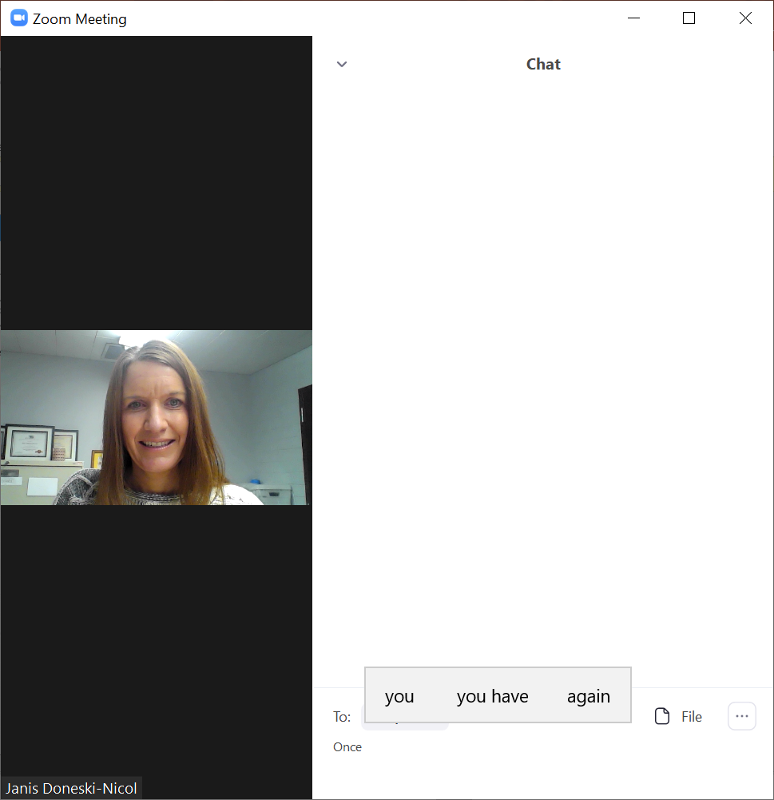
Word Prediction in Zoom

Slide 4


Select the Windows Key Followed by the Settings Key

Slide 5
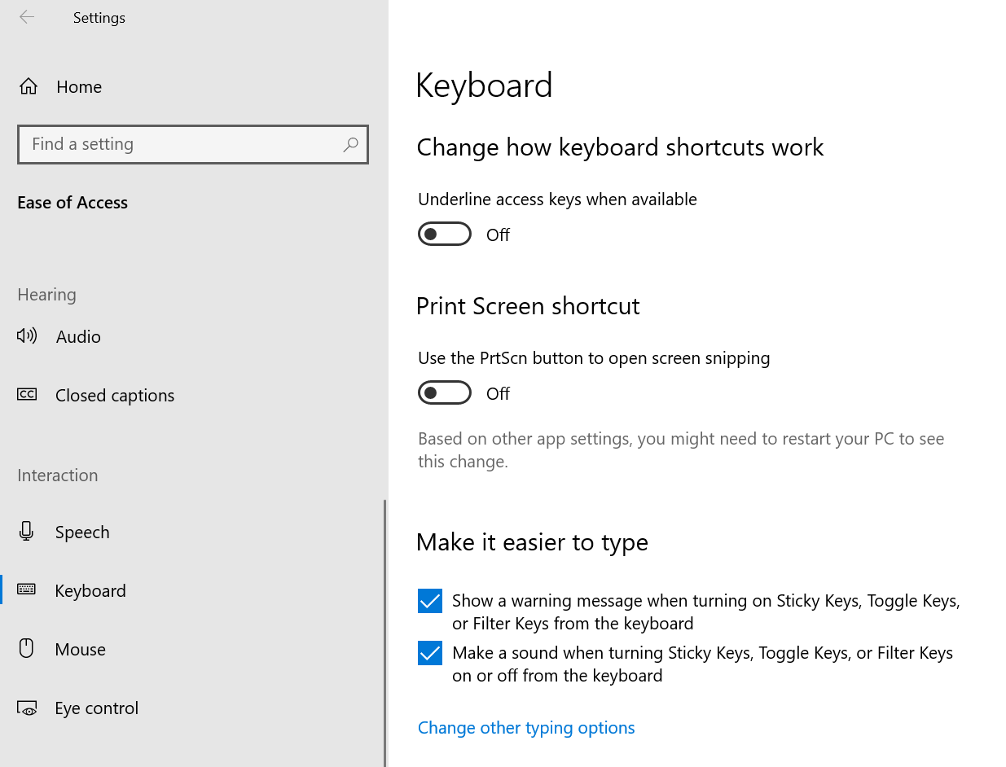

Slide 6
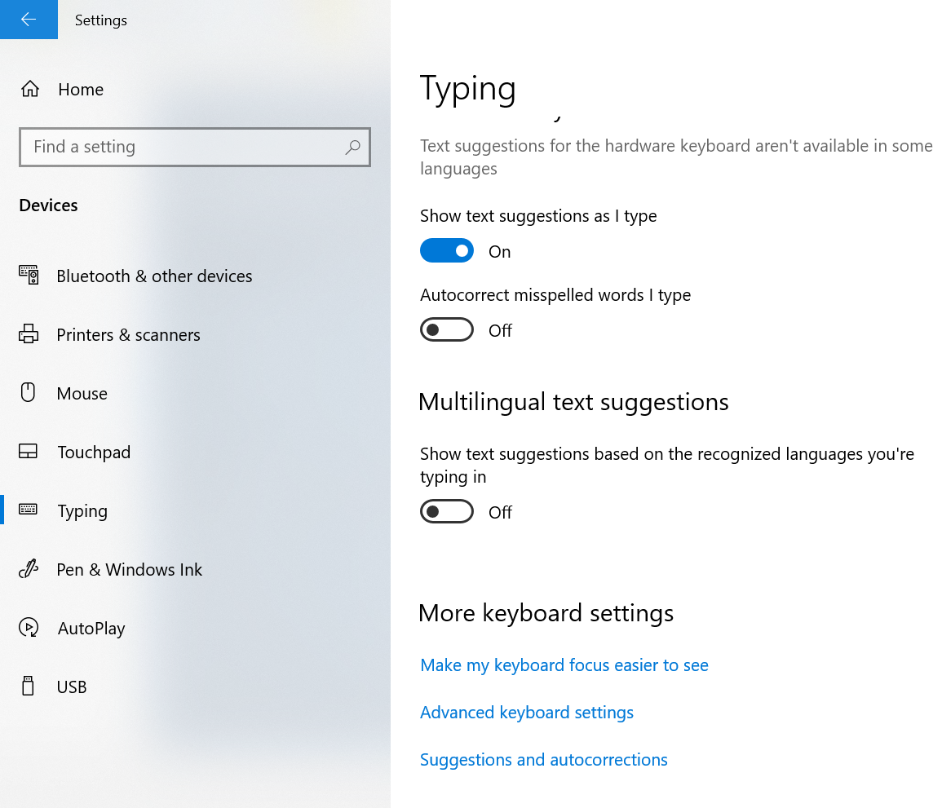

Slide 7
Immersive Reader

Slide 8
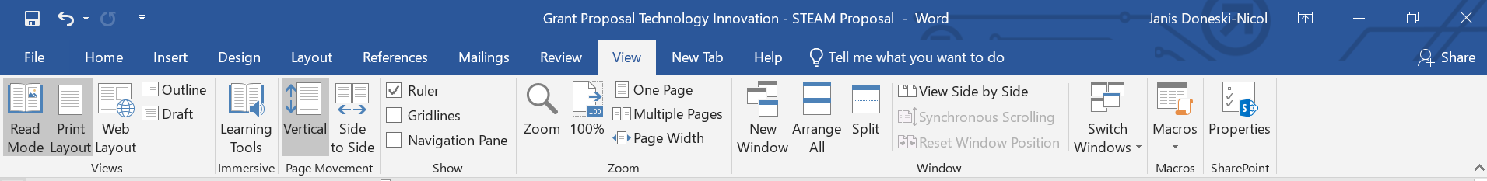
Immersive Reader is a tool which will read text to you in Microsoft Word.

Slide 9
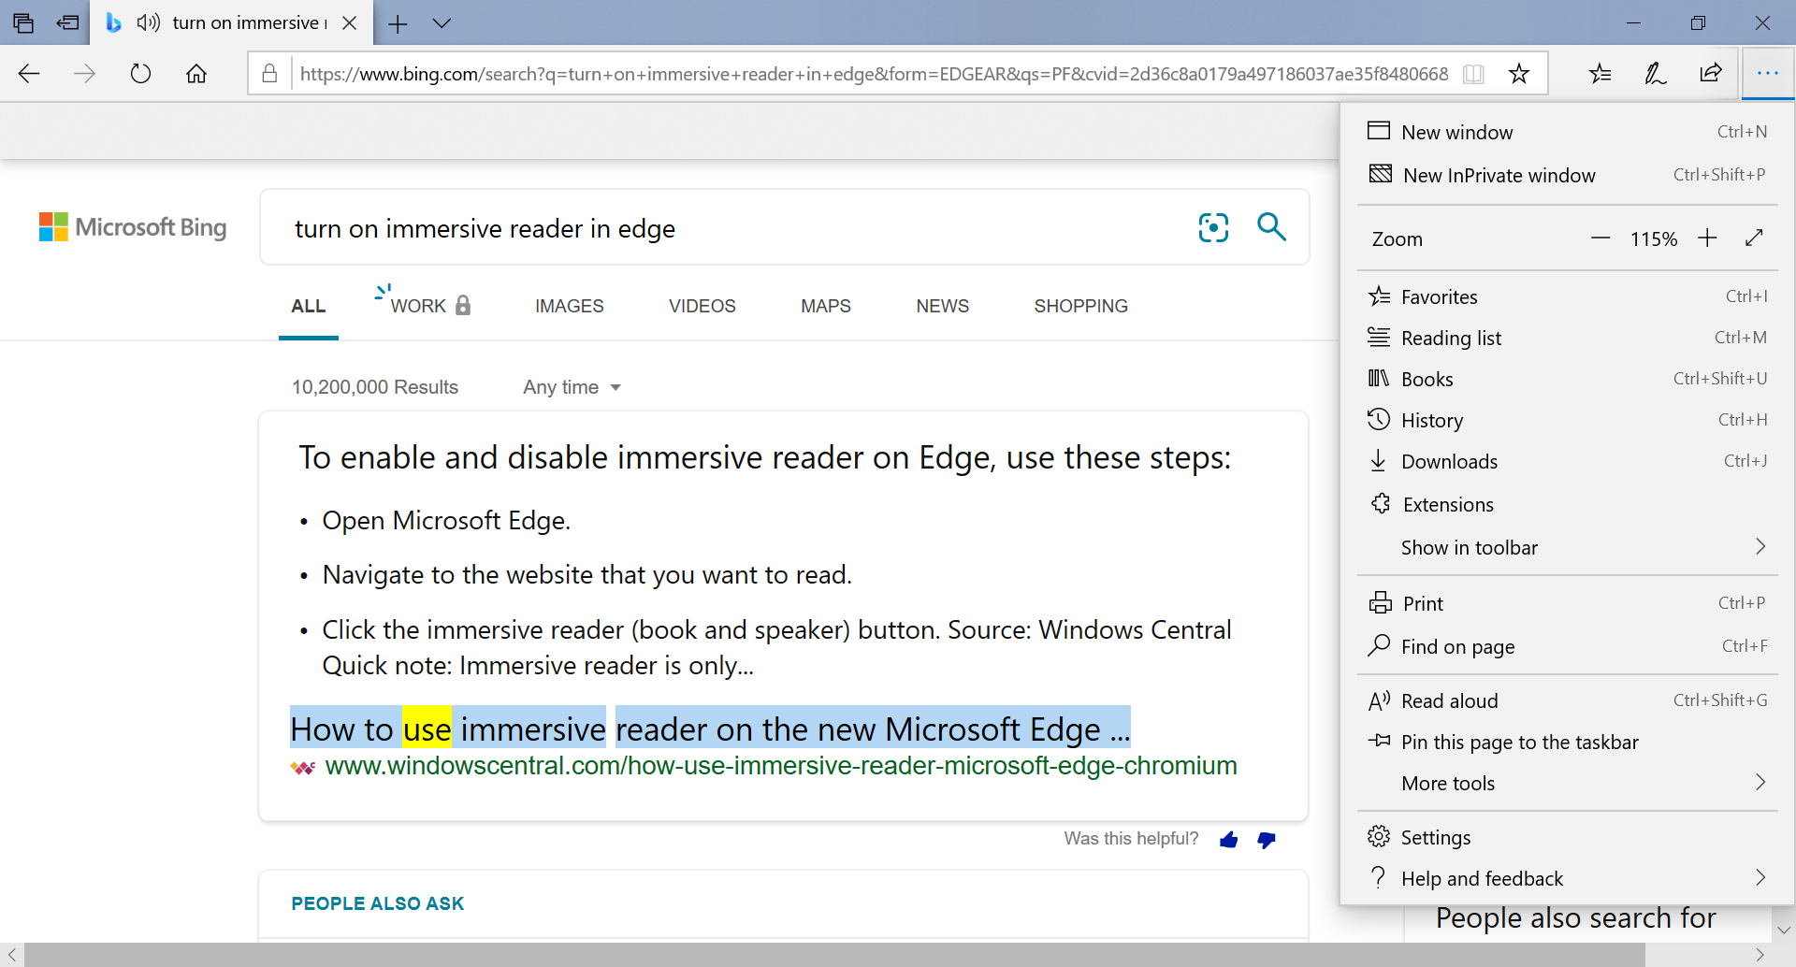
Immersive Reader is also available in Microsoft Edge.

Slide 10
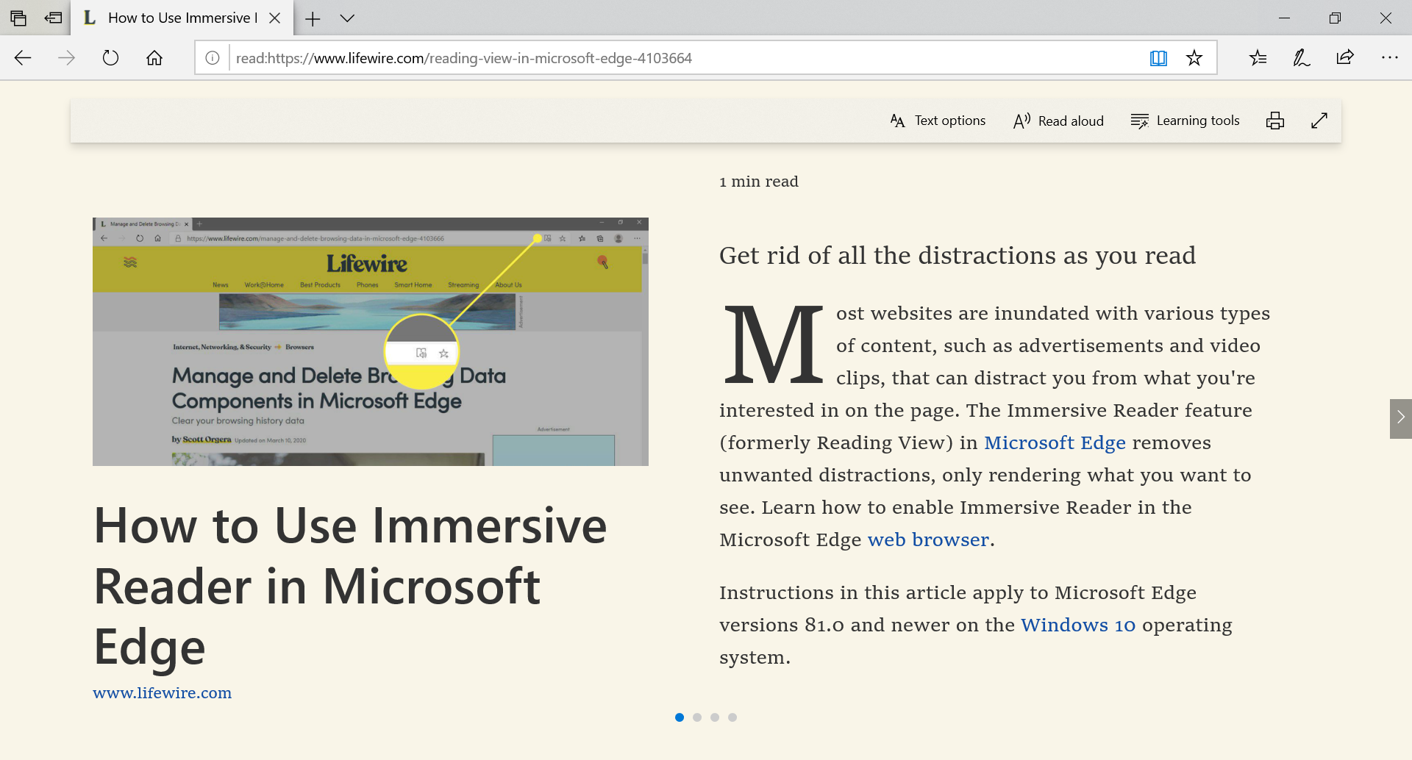
Ctrl + Shift + R quickly turns on Immersive Reader in Microsoft Edge (browser)

Slide 11
Speech to Text

Slide 12
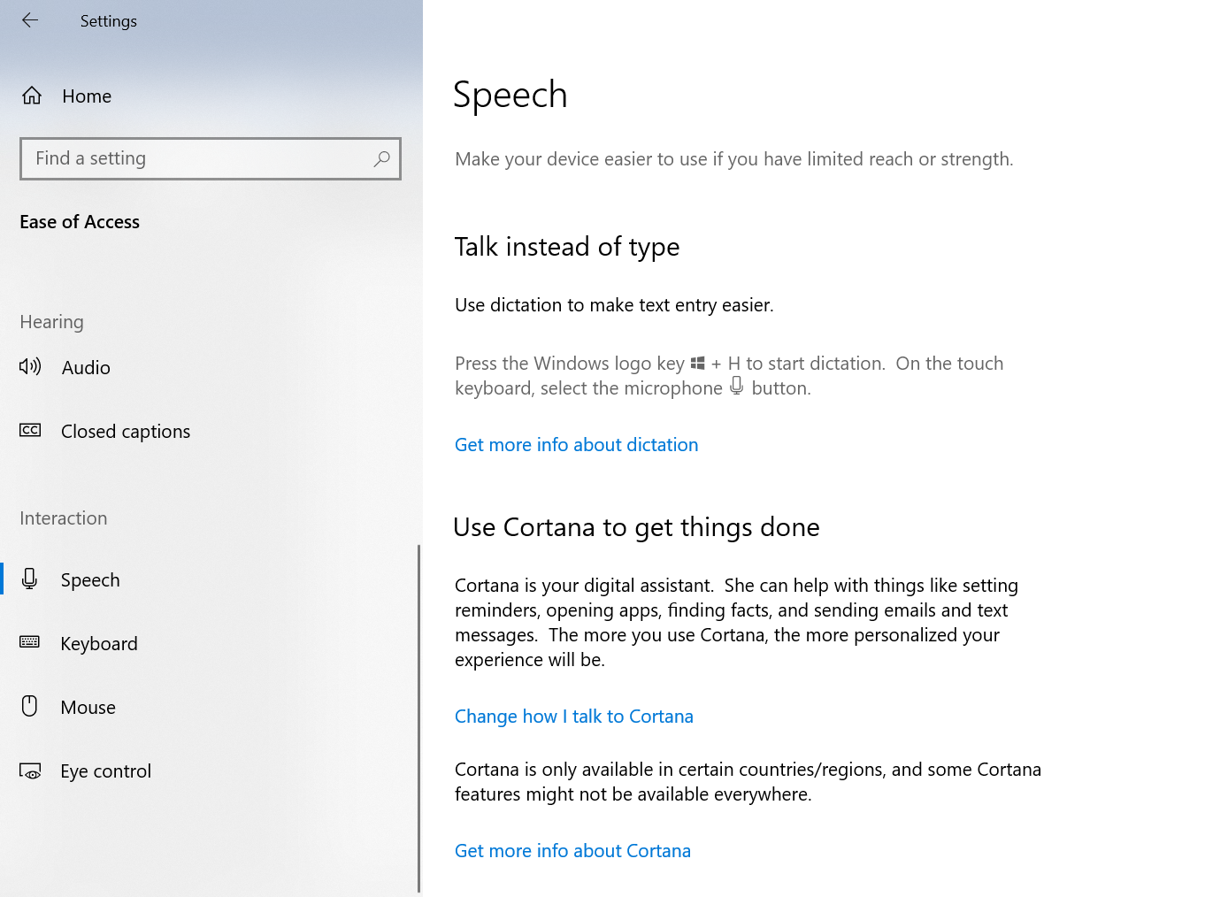
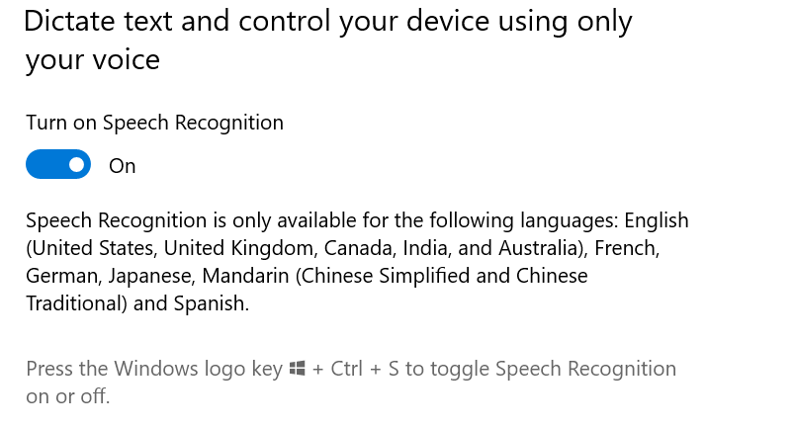
Use the Windows Key + H to turn on voice recognition or dictation. This will work in most areas you can type in.

Slide 13
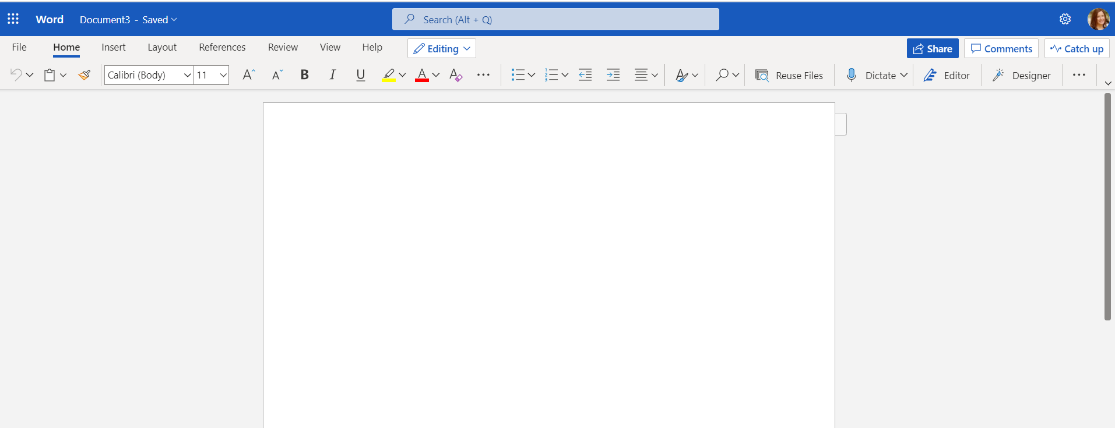
Microsoft Word 365

Slide 14
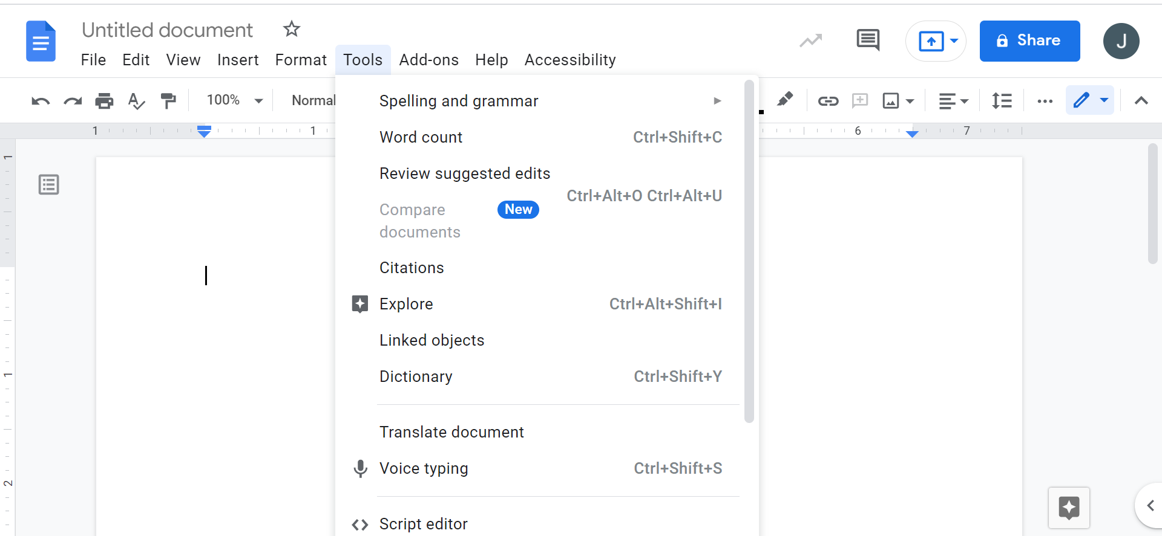
Google Docs (When Opened in Chrome)

Slide 15
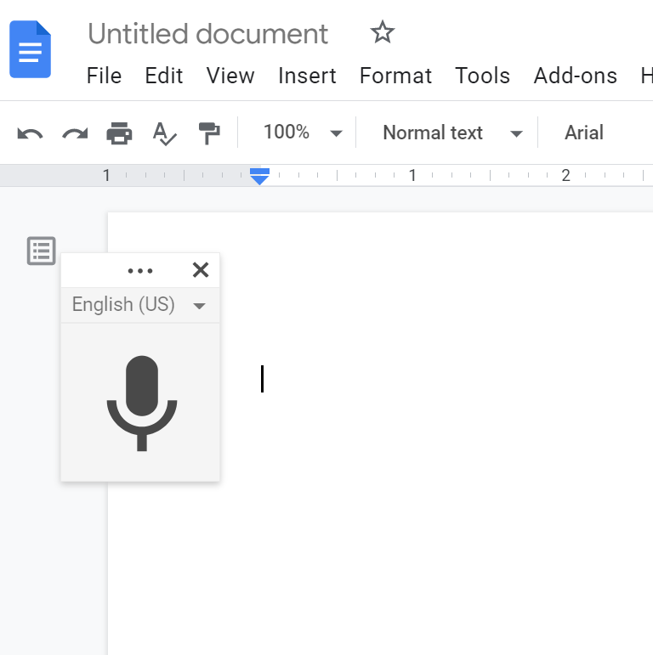
Google Docs (When Opened in Chrome)

Slide 16
Graphic Organizer

Slide 17
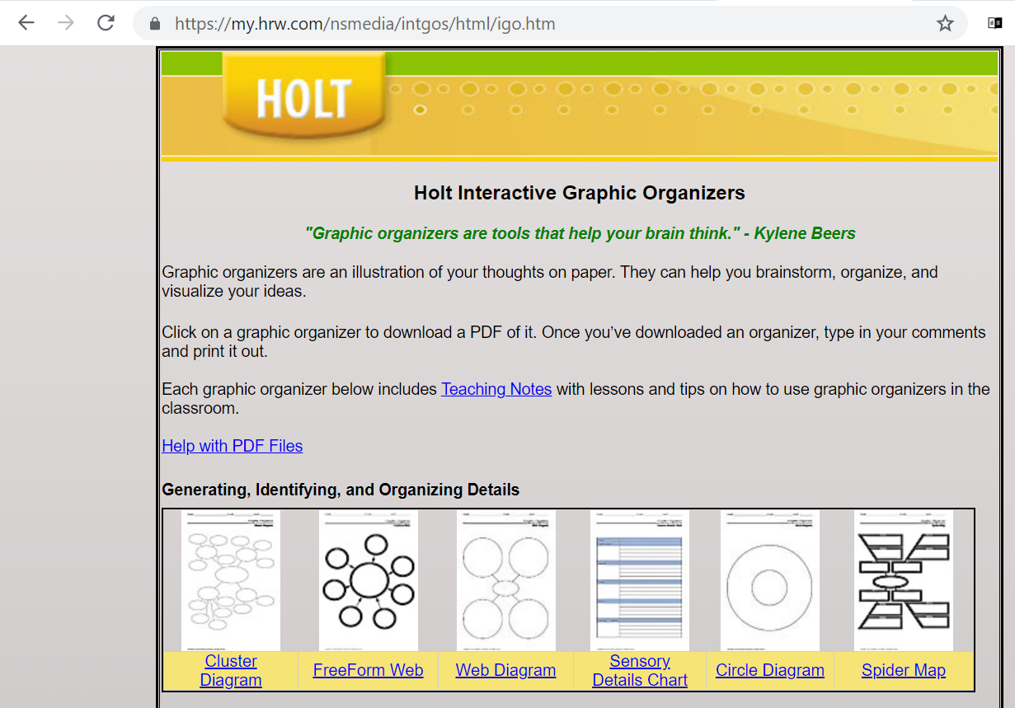
https://my.hrw.com/nsmedia/intgos/html/igo.htm
This is an option for organizing writing assignments. Graphic organizers can also be helpful when reading and organizing comprehension.

Slide 18
Math Supports

Slide 19
Microsoft Office One Note
One Note is available if you have Microsoft Office on your computer. One Note will show you how to solve math problems.
This link shows the process https://support.microsoft.com/en-us/office/solve-math-equations-with-math-assistant-in-onenote-1b37bb8d-ecd1-40d7-8d0f-5e6e46547441
This is a quick video about One Note and math.

Slide 20
Summarize Text

Slide 21
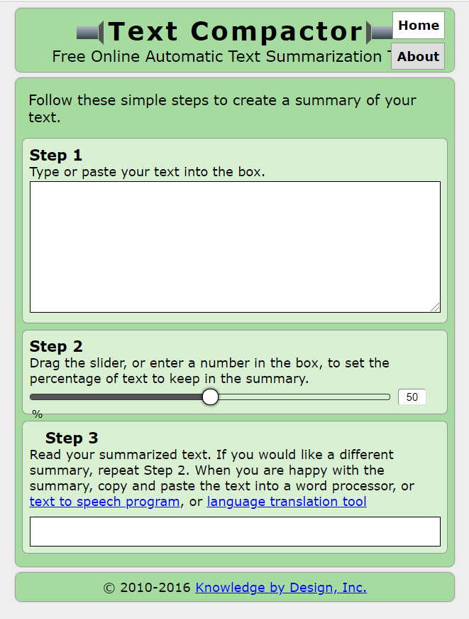
Summarize Text With Text Compactor
This tool may be useful to activate background knowledge and provides a pre-read prior to reading a long text.
https://www.textcompactor.com/

Slide 22
Vocabulary Supports

Slide 23
Rewordify https://rewordify.com/
Rewordify.com is powerful, free, online software that improves reading, learning, and teaching. This site can:
  Intelligently simplify difficult English, for faster comprehension
  Effectively teach words, for building a better vocabulary
  Help teachers save time and produce engaging lessons
  Help improve learning outcomes
The site is free and child-safe. Use it now; there's no software to install. Try the online demo and the first-time user guide. Teachers: You can print free, full-color literature to get started. Scroll down for more info...

Slide 24
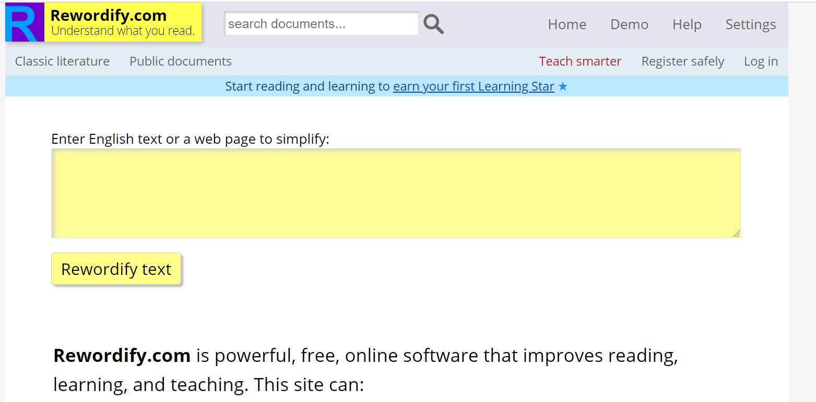
Vocabulary Supports
https://rewordify.com/

